Slide 1


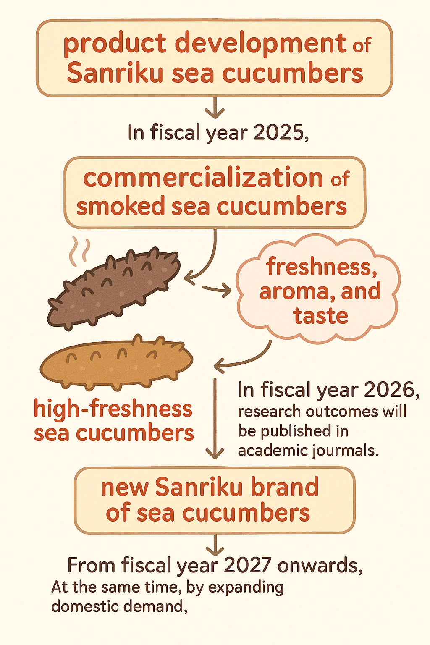
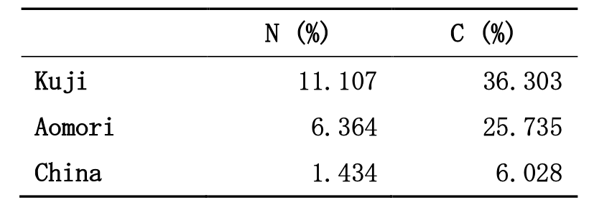
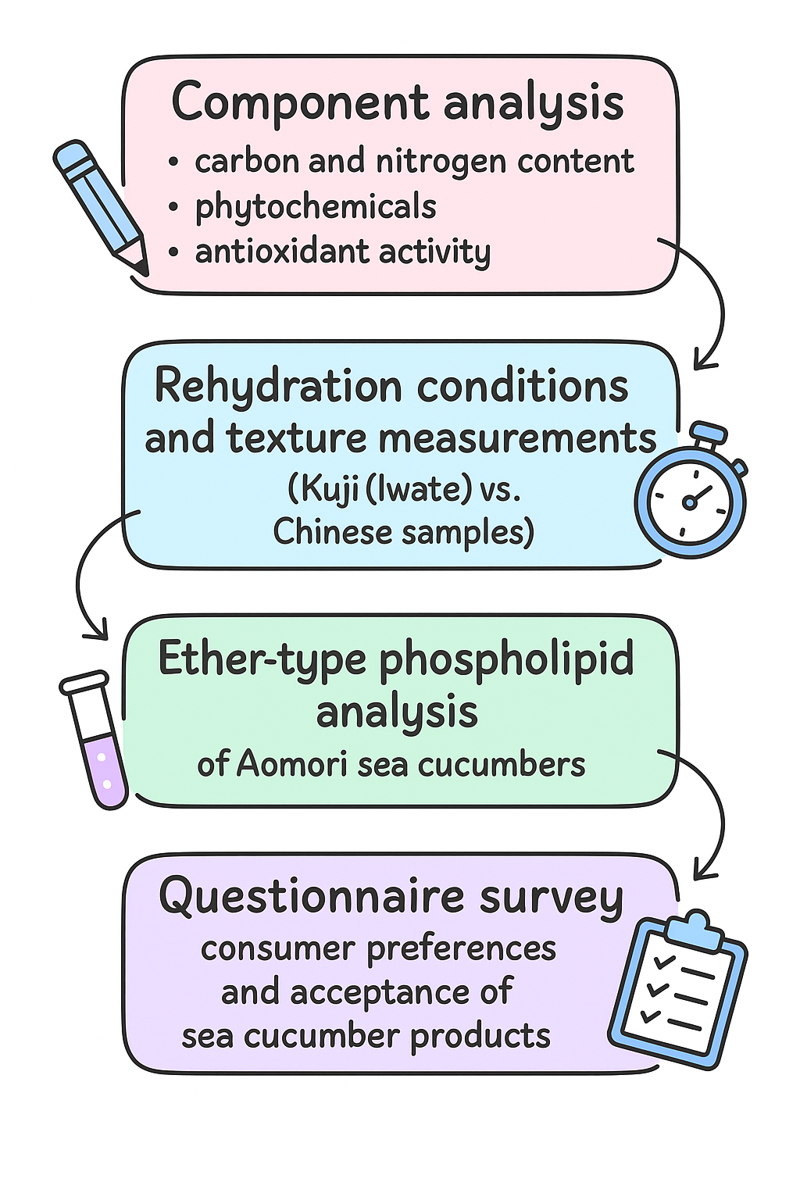
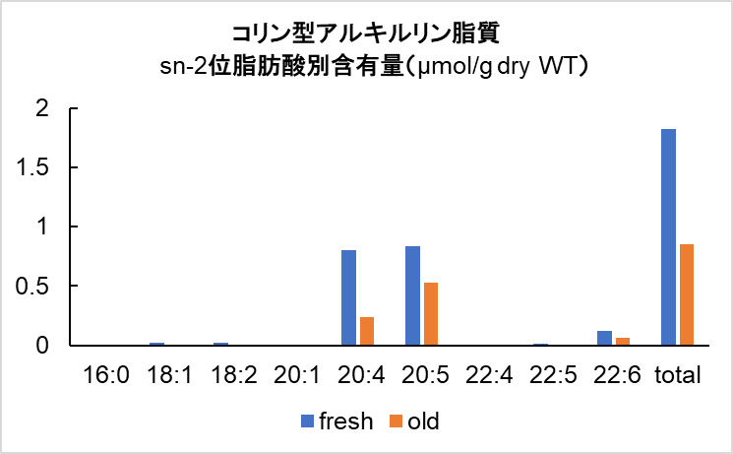
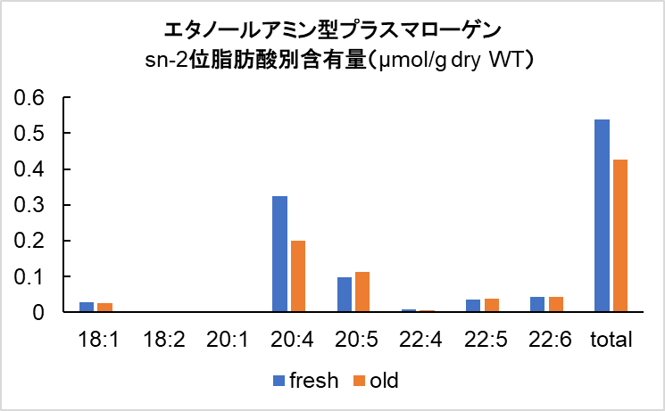
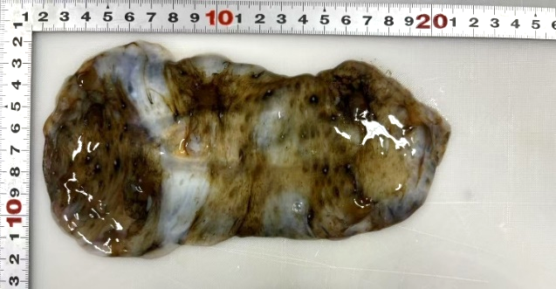
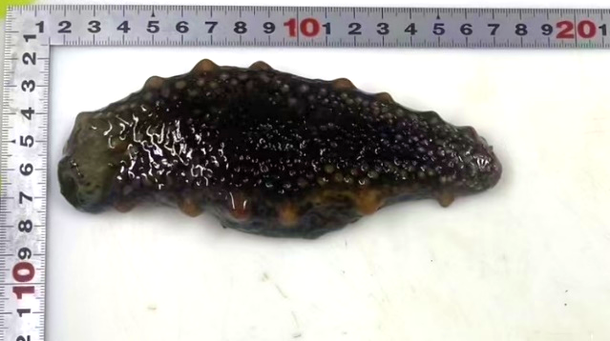
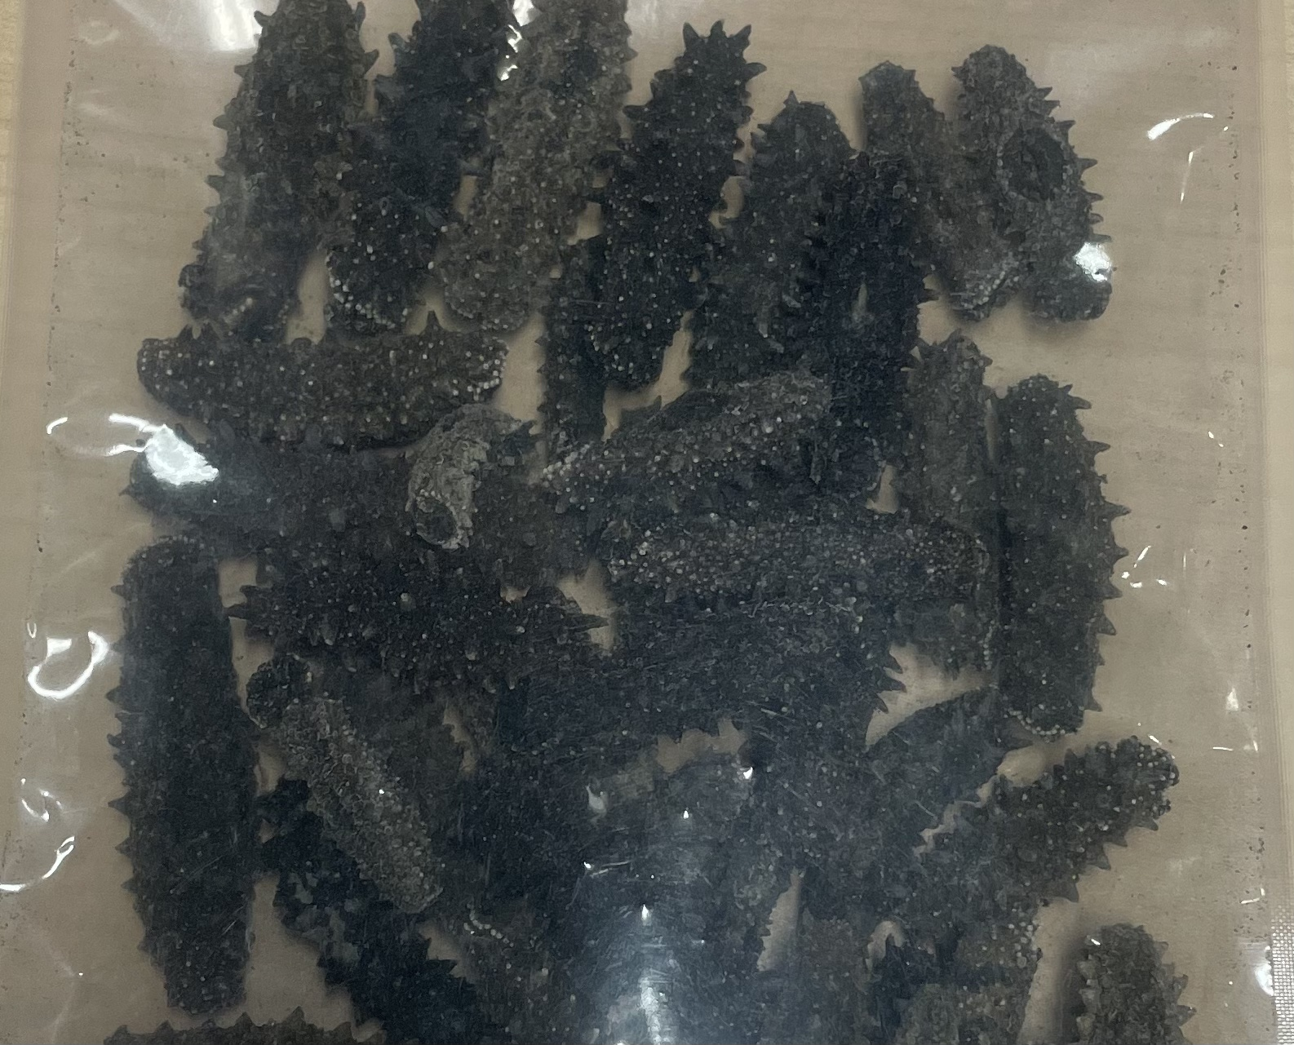
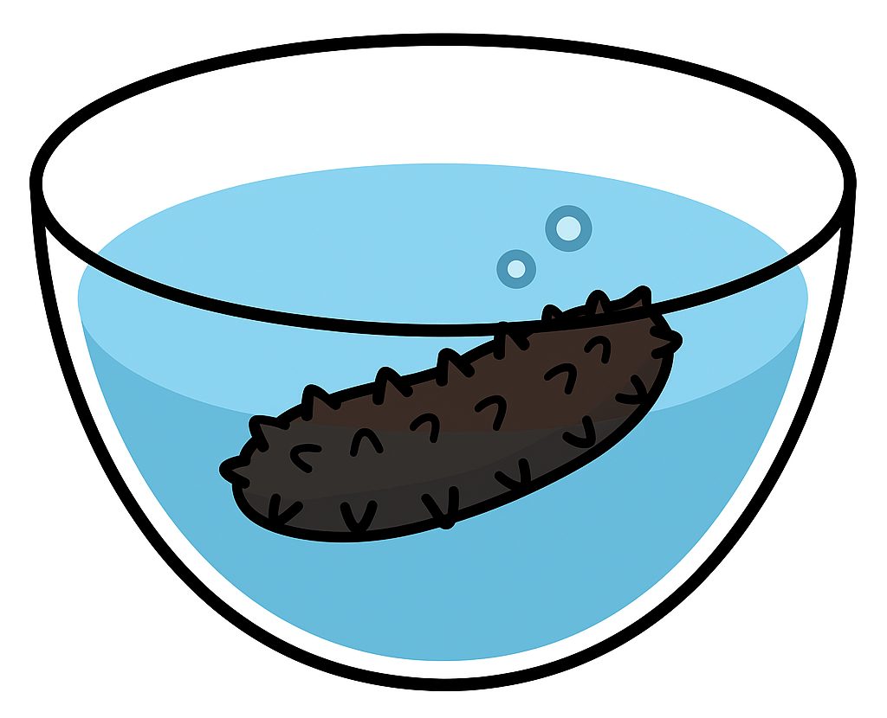
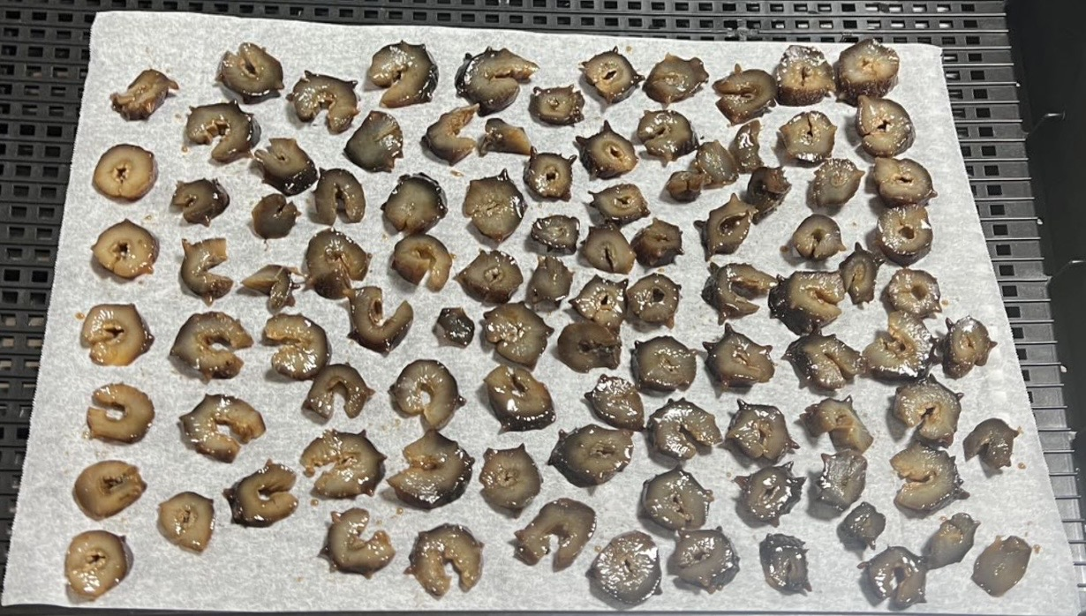
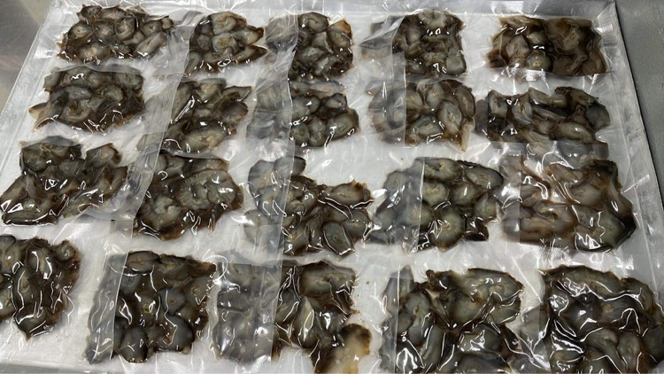
FSMILE 2025
Development of High Value-Added Products Based on the Raw Material Characteristics
of Sanriku Sea Cucumbers
October 04-07, 2025
@Morioka & ZOOM Cloud
International Symposium on Food Communications and Sustainable Agri-Aqua Food Systems
Connecting Primary Industries, Academia, and Society through the SDGs
M. KUMAGAI , C. YUAN
Faculty of Agriculture, Iwate University, Morioka, Japan
Contact Information: Manaka Kumagai
Affiliation: Faculty of Agriculture, Iwate University E-mail: g0124014@iwate-u.ac.jp
Introduction
Sea cucumber (Stichopus japonicus) is a highly valued echinoderm in Japan and China, recognized for its culinary and cultural significance as well as its rich nutritional profile with numerous bioactive compounds. In Japan, efforts to promote domestic consumption and strengthen the local market are underway, and these initiatives have become urgent in order to reduce reliance on overseas markets.
Results１
Rehydration: Kuji >10-fold, Chinese ~2-fold; soaking period depends on liquid.（Figure 1）
Texture: Kuji (green tea, cube) strongest; Chinese weakest .(Figure 2)
C/N content: Kuji > Aomori > Chinese; Chinese diluted by high salt. (Table 1)
Antioxidants: 70% ethanol extract strongest; identified saponins, flavonoids, etc.(Table 2)
Phospholipids: Fresh Aomori rich in plasmalogens (EPA, DHA); levels drop with aging.
Minerals: Kuji high in Ca, Chinese high in Mg; minerals leach out during soaking.
Consumer survey: Older = like texture; Younger = dislike appearance. Smoked sea cucumber most preferred.
Kuji（Japan）
Chaina
Future perspective
In fiscal year 2025, product development of Sanriku sea cucumbers will begin, aiming for a patent application. The study will also explore the relationship between freshness, aroma, and taste to improve consumer acceptability, and develop novel products using high-freshness sea cucumbers.
In fiscal year 2026, research outcomes will be published in journals. From 2027 onwards, commercialization will establish a new Sanriku brand of sea cucumbers, while expanding domestic demand to stabilize the integrated aquaculture and fisheries system in the Sanriku region.
Figure 1. Rehydration rate of dried Kuji（久慈） and Chinese（中国） sea cucumbers. (Water（水）: rehydrated with water; Green（緑）: rehydrated with green tea; Rice（米）: rehydrated with rice-washing water.Rehydration rates were measured after 3, 5, and 7 days.)
Cube (1.0 cm block)
Cylinder (0.5 cm slice)
AIM
To revitalize the regional fisheries industry, expanding domestic consumption is essential. Since Hokkaido dominates in production volume, Sanriku sea cucumbers must be differentiated through quality, freshness, and value-added processing. This study compares Sanriku (Aomori and Kuji) and Chinese sea cucumbers to elucidate their functional properties, the impact of freshness on quality, and their potential for brand development.
Figure 2. Gel strength of dried Kuji（久慈） and Chinese（中国） sea cucumbers after rehydration. (Water（水）: rehydrated with water; Green（緑）: rehydrated with green tea; Rice（米）: rehydrated with rice-washing water.Measurements were taken after 7 days of rehydration.)
Extracts
Extraction yield (%)
Total phenolic content
Total flavonoid content
Extracts | DPPH EC₅₀ (mg/ml) § | ABTS EC50 (mg/ml) § | CUPRAC ECA0.50 (mg/ml) δ
100M | 5.46 ± 0.09c | 4.73 ± 0.16b | 0.31±0.00c
70M | 16.41 ± 0.75a | 6.33 ± 0.31a | 0.74 ± 0.00a
100E | 14.37 ± 0.50b | 4.19 ± 0.12c | 0.36 ± 0.01b
70E | 4.05 ± 0.04d | 2.47 ± 0.05d | 0.22 ± 0.00d
Table 1. Nitrogen and carbon contents of sea cucumbers from different regions
Table 2. Effect of extraction solvents on yield and phytochemical content of Kuji sea cucumber extracts
Table 3. Antioxidant activity of Kuji sea cucumber extracts obtained with different extraction solvents
Method
Results 2
Freshness of sea cucumbers
Freshness is a critical quality attribute of sea cucumbers, as biochemical composition and texture properties change rapidly after harvest.
Loss of freshness in sea cucumbers leads to autolysis and significant reduction of functional components such as ether-type phospholipids and plasmalogens.
Storage conditions strongly affect sea cucumber freshness, influencing both texture and biochemical stability.
Rehydration properties and gel strength can be considered indirect indicators of freshness and raw material quality in dried sea cucumbers.
Content of fatty acids at the sn-2 position
in choline-type alkyl phospholipids (μmol/g dry WT)
Content of fatty acids at the sn-2 position
in ethanolamine-type plasmalogens (μmol/g dry WT)
Acknowledgements
We are sincerely grateful to all members of the Fisheries Food Processing and Marketing Laboratory for their generous advice, encouragement, and support. This research was funded by Sanriku Fundation.
Figure 3. Ether-type phospholipid composition in Aomori sea cucumbers
References
Fukunaga, Toshiko, Changes in composition and tissue structure due to water return of dried seam (Kinko), TAGE Top Journal of the
Japanese Society of Cooking Science, Volume 35, 2002, No. 4, pp 357-361
Yamana, Yusuke, Recent trends in the research of Japanese naps in the fish and taxonomy, Journal of the Japanese Bentos Society, Volume 75, 2020, pp 6-18
Narita, Masanao, Establishment of quality standards for dried sea cucumber, Hokkaido Abashiri Fisheries Test Stam Project Report, Volume 2009, 2010, pp 61-63
Figure 4. Freshness changes in sea cucumbers under different storage conditions (Photo 1: Sea cucumbers stored at a supermarket, day 2. Photo 2: Sea cucumbers stored in the laboratory, day 2.)

